Slide 1
Generative AI ...
Qing Wang, Ph.D.
06/02/2023
Notes:
Good Morning, everyone. My name is Qing Wang, a data scientist in AICAP team. Today, I’m going to talk about the current most popular topic: Generative AI, which is making waves around this real world. Okay, let’s begin our AI journey.

Slide 2
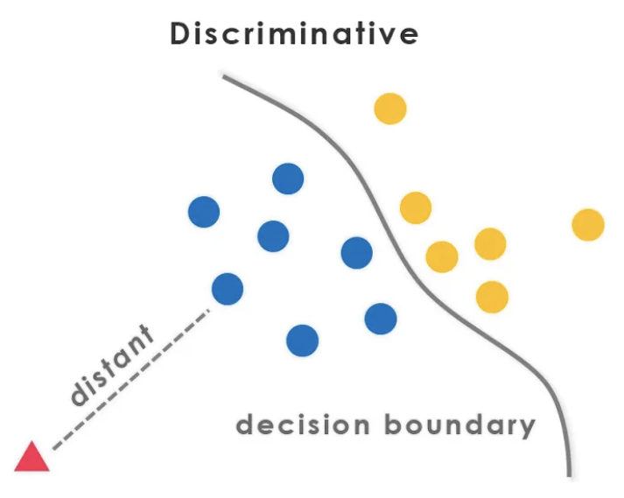
Discriminative models vs Generative models
Discriminative model:
learns a predictor given the observations.
captures the conditional probability $p(Y|X)$, e.g., SVM
Discriminative models try to learn a hyperplane to separate the different classes.
- e.g., a line in a 2D space.
- or, a 2D plane in a 3D space.
Notes:
In machine learning or AI, one major division is generative versus discriminative modeling, which you must be heard from any intro level machine learning course.
Discriminative model, learns a predictor given the observations and in a more formal way, it captures the conditional probability of Y given X. For example, a very classic classification model, SVM.
Discriminative models try to learn a hyperplane, or you could say a decision boundary to separate the different classes.

Slide 3
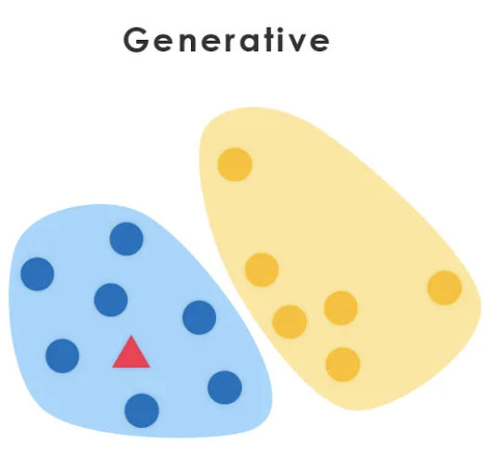
Discriminative models vs Generative models
Generative model:
aims to solve the more general problem of learning a joint distribution over all variables.
$\text{c}\text{aptures} \text{the} \text{joint} \text{probabilit}y p(X, Y)$, e.g., Naïve Bayes.
In other words, a generative model simulates how data is generated in the real world.
Notes:
While generative models try to solve more general problem of learning a joint distribution over all variables. In other words, a generative model simulates how data is generated in the real world.

Slide 4
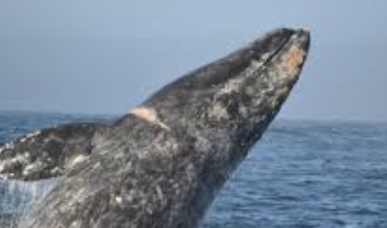
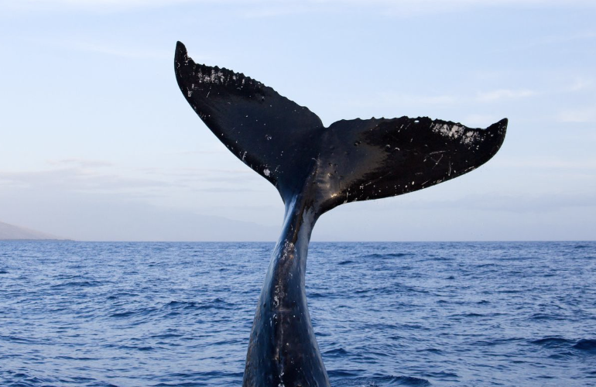
Generative AI Models Are Hard
Many generative models:
Text generation: Long Short-Term Memory Networks (LSTMs), Recurrent Neural Networks (RNNs), GRUs, etc.
Image generation: Generative Adversarial Networks (GAN), SeqGAN, GraphGAN, AttentionGAN, etc.
Generative Models
Discriminative Models
capture correlations
capture significant patterns
…
Y=1
AI Generated
Y=0
Notes:
You must be familiar with some generative models for text generation or image generation.
Generative AI models tackle a more difficult task than discriminative models. Generative models have to model more.
For example, a generative model for images might capture correlations like “things look likes a boat are probably going to appear near things that look like water” These are very complicated distributions.
In contrast, a discriminative model tries to tell the difference between “boat” or “not boat” by just looking for a few significant patterns.
Given a large corpus of sequence data, LSTM models can be designed to learn the general structural properties of the corpus, and when given a seed input, can generate new sequences that are representative of the original corpus.

Slide 5
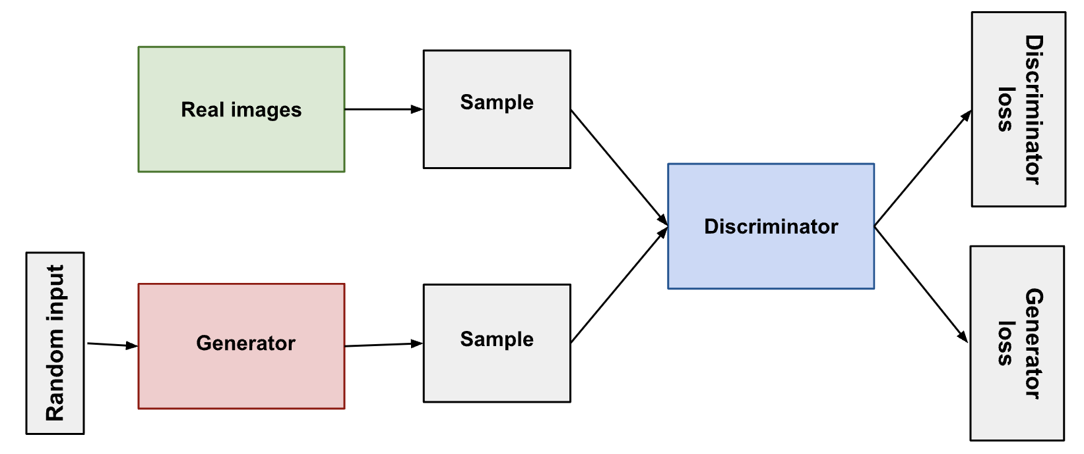
Generative AI Models Are Hard
GANs
Do I look like Benjamin Franklin?
Lol, I am a real image!
Notes:
A generative adversarial network (GANs) is a class of machine learning frameworks for approaching generative AI, by estimating generative models via an adversarial process.
GANs has two main components: generator and discriminator. Both losses from discriminator and generator are used to train for better generated results.

Slide 6
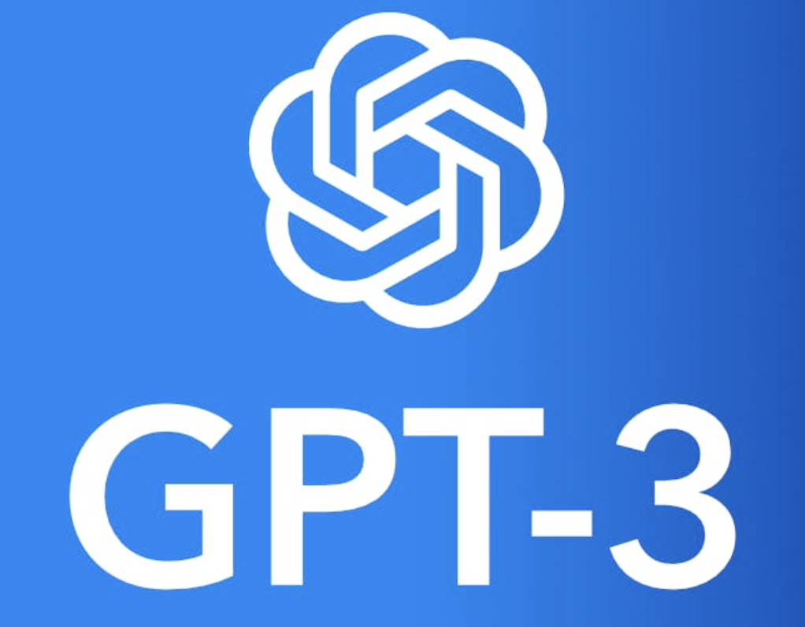
ChatGPT AI Bots Conversation
https://youtu.be/rb_1-zxK0fQ
Two AI Bots Conversation written by ChatGPT.
GPT-3, a state-of-the-art language model made up of 175 billion parameters, while GPT-2 model with only 1.5 billion parameters.
GPT-4 is reportedly about six times larger than GPT-3.
Notes:
ChatGPT, a type of large language model, it is still a generative model. It tries to model the distribution of the data space. That’s why it can not capture the latest information for conversations.

Slide 7
Understanding ChatGPT
Discriminator
h
En
De
Scalar (REWARD)
Sequence Generator
x
$$θ$$
update parameters
SeqGAN Model
h: real data
x: data generated by Generator.
use the output of Discriminator as REWARD
update generator’s parameters to improve discriminator to get the maximum reward
Notes:
GANs model can hardly generate sequence data, which is discrete. But some researchers solved it by coming up with SeqGAN model.

Slide 8
Understanding ChatGPT
How does Discriminator provide the REWARD for Generator?
e.g., D(“What is your name?”, “I’m Qing Wang. ”) + 1.0
e.g., D(“What is your name?”, “I’m Super COOL. ”) + 0.8
e.g., D(“What is your name?”, “I’m happy. ”) + 0.1
e.g., D(“What is your name?”, “I don’t know.”) + 0.1
Notes:
Here, we try to understand a tiny piece of the puzzle for ChatGPT through seqGAN model.

Slide 9
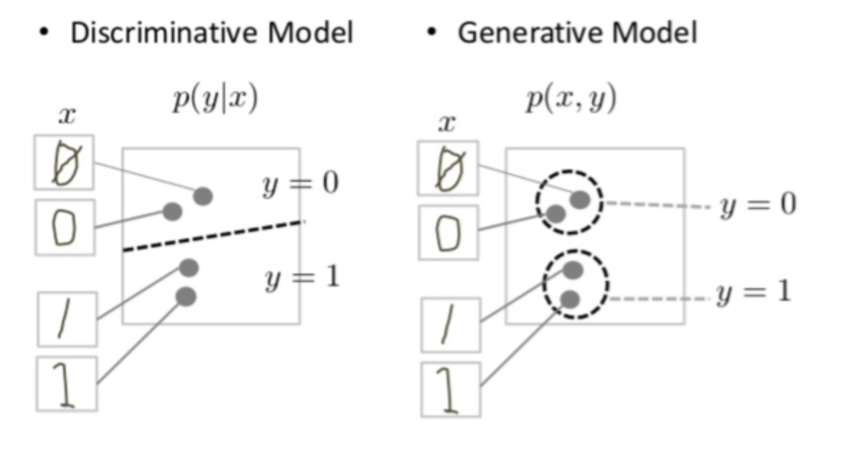
TAKEAWAY
Generative models can generate new data instances.
Discriminative models discriminate between different kinds of data instances.
Discriminative Model and Generative Model of Handwritten Digits
Notes:
The discriminate models tries to tell the difference between handwritten 0’s and 1’s by drawing a line in the data space,
While the generative model has to model the distribution throughout the data space.

